Slide 1


MACHINE LEARNING TRACK — TASK 2
Uber Fare
Prediction
Data Preprocessing & Regression Modeling for the Uber Fare Dataset.

Slide 2
PROJECT OBJECTIVE
Prepare Data & Build Regression Model
Primary Goal
KEY EXECUTION STEPS
Transform raw Uber dataset for modeling and build an accurate machine learning pipeline to predict trip fare amounts.
Handle missing values
Remove duplicates
Encode categories
Scale numeric features
Detect outliers
Train/Test Split & CV
Tune hyperparameters
Evaluate performance

Slide 3
DATASET OVERVIEW
Raw Data Profile
487,742
26
fare_amount
TOTAL ROWS
COLUMNS
TARGET VARIABLE
0
0
390K / 97K
Missing Values
Duplicate Rows
Train / Test Split
In selected features.
Exact matches removed.
Training vs Testing samples.

Slide 4


DATA QUALITY
Missing Values & Duplicates
Missing Values
Exact Duplicates
0
0
No missing values found in selected features.
Checked prior to modeling.
Result: No imputation required.
Result: Dataset remained at 487,742 rows.

Slide 5
CATEGORICAL PROCESSING
Feature Encoding Strategies
Different encoding strategies applied based on feature nature.
Ordinal Encoding
One-Hot Encoding
Car Condition Feature
Weather
Traffic Condition
Bad 0
Good 1
Very Good 2
Prevents model from assuming artificial numerical relationships between nominal categories.
Excellent 3

Slide 6

PIPELINE ARCHITECTURE
Scaling & Scikit-Learn Pipeline
StandardScaler
All numerical features standardized identically.
FULL PREPROCESSING PIPELINE
Imputation
Median & Most-Freq
Encoding
Ordinal & One-Hot
Scaling
StandardScaler
Feature Selection
Model Inputs
Why use a Pipeline?
Applies preprocessing consistently across train/test splits. Eliminates data leakage risk.

Slide 7
DATA QUALITY
Outlier Detection (fare_amount)
IQR method applied to target variable.
Lower Bound | -3.75
Upper Bound | 22.25
DETECTED OUTLIERS
8.64%
Action Taken: Retained
33,702 trip records
Outliers were identified but not removed. Unusually high fares represent valid, real-world long-distance trips.

Slide 8

MODEL PREPARATION
Data Split & Cross-Validation
Strict Separation
Test set isolated completely during preprocessing and tuning.
80%
random_state = 42
TRAIN
5-Fold Cross-Validation
Used for baseline evaluation and hyperparameter tuning. Provides reliable estimation of performance.
TRAINING SET
TESTING SET
390,193
97,549

Slide 9
INITIAL MODELING
Baseline Model: Linear Regression
Establishes a foundational reference point before tuning complex models.
Evaluation Metric | Cross-Validation | Test Set
Mean Absolute Error (MAE) | 2.4369 | 2.4143
Root Mean Squared Error (RMSE) | 4.9585 | 4.8874
R² Score | 0.7319 | 0.7368

Slide 10

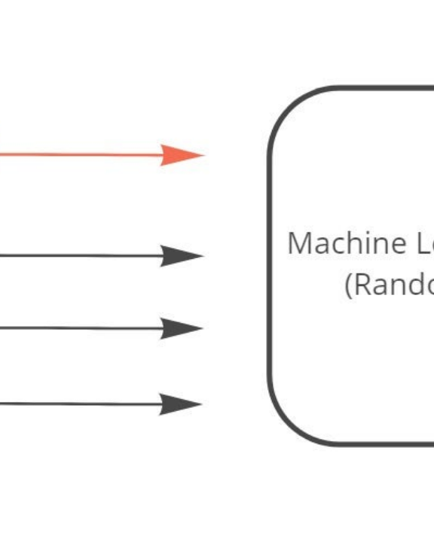
OPTIMIZATION
Random Forest Regressor
Selected for flexibility. Tuned via RandomizedSearchCV.
BEST PARAMETERS FOUND
n_estimators = 73
max_depth = 20
max_features = 0.7
min_samples_split = 5
min_samples_leaf = 5
BEST CROSS-VALIDATION RMSE
3.6028

Slide 11
EVALUATION
Final Model Comparison
Model | MAE | RMSE | R²
Linear Regression (Baseline) | 2.4143 | 4.8874 | 0.7368
Tuned Random Forest | 1.6465 | 3.4732 | 0.8671
Test Set Performance
0.8671
The Random Forest model demonstrates robust generalization on unseen data, explaining ~86.7% of fare variance.
FINAL R² SCORE

Slide 12
SUMMARY
Conclusion
Data Preparation
Data Cleanliness
Successfully formatted for regression modeling.
Zero missing values or duplicate rows found.
Feature Engineering
Outlier Strategy
Categorical encoding and numeric scaling within pipeline.
High-fare potential outliers identified and retained.
Model Tuning
Deployment Ready
Random Forest optimized via RandomizedSearchCV.
Final pipeline saved using Joblib for future predictions.

Slide 13
NEXT STEPS
Future Improvements
Deeper Tuning
Advanced Models
Outlier Deep-Dive
Perform more extensive hyperparameter search grid.
Experiment with Gradient Boosting and XGBoost.
Investigate detected high-fare trips in more detail.
Feature Engineering
Error Analysis
Outlier Treatments
Add meaningful interaction and time-based features.
Analyze prediction errors across distinct fare ranges.
Compare model performance using different outlier strategies.

Slide 14
Thank You
Questions?

Slide 15


Image Sources
https://images.stockcake.com/public/f/4/4/f44ece57-e961-4876-9c70-452e90697812_large/futuristic-network-grid-stockcake.jpg
Source: stockcake.com
https://assets.insightmediagroup.io/media/wp-content/uploads/2021/01/1B-Gwgsk4MQj_Bws64W_wjw.jpeg
Source: towardsdatascience.com

